Slide 1
Experience OF al-farabi kazakh national university in the implementation of the European credit transfer system: workload of student and teacher in the ects format
D.Zh. Ahmed Zaki,
Vice-Rector for Academic Affairs,
Al-FarabiKazakh National University

Slide 2
ECTS is projected on
The development of educational programmes
The calculation of workload and planning of the student educational load
Earning and transfer of credits
Planning teaching load of the faculty
Assessment system
Organisation of independent work of students
Diploma Supplement

Slide 3
ECTS METHODOLOGY AND RECOMMENDATIONS
 | ECTS | RECOMMENDATIONS
Development of educational programmes | Requires connection of the educational program me with the framework of qualifications; Provides flexibility when developing curriculum of educational programme; Requires the formed institutional culture of use of the credit system; Requires descriptors for each level of competence; Allows credit earning without harsh initial orientation to the awarding qualifications (individual flexible learning paths); Learning outcomes reflect the level of competence formed by the end of study; The number of credits assigned to each component of the educational programme is consistent with its "weight" in terms of the complexity of student workload to achieve the learning outcomes; Credits earned in one program me may be transferred to another educational programme. It promotes the development of the autonomy of higher education institutions and responsibility for all decisions concerning students' learning outcomes; Catalyses the improvement of the quality of the educational process, organizational and administrative work; | To develop a mechanism to analyse the compliance of the learning outcomes of the educational programme with competences defined by sectoral qualifications frameworks; To implement a mechanism providing the opportunity to learn disciplines and gain credits of a HEI component for the foundation; To introduce the unified workload of a credit, regardless of the learning activities of students; To implement a system of external evaluation of the degree of development of learning outcomes by means of intermediate measurings taking account of the estimated time of the formation of the competence and the respective credit earnings.

Slide 4



LINK BETWEEN COMPETENCES AND NUMBER OF ECTS CREDITS
The number of credits being awarded to the discipline directly depends on the number of generated learning outcomes and their level of complexity
5 ECTS
7, 5 ECTS
complexity
complexity
Learning outcomes: the ability to plan, implement and document an ethnographic project using qualitative data obtained through interviews and observations.
Learning Outcomes: Understanding the basics of strategic planning and global marketing process and others.

Slide 5

ECTS METHODOLOGY AND RECOMMENDATIONS
 | ECTS | Recommendations
The calculation of the complexity of study and planning the workload of students | Requires focus on the student in the accumulation and credit transfer; It provides transparency of results and learning processes; The complexity of the workload depends on the time it takes for the average student in all forms of study to achieve the expected learning outcomes. | To develop a methodology for evaluation of the course or curriculum from the point of the adequacy of the chosen forms of educational activity and their complexity against the expected learning outcomes; Flexible distribution of contact hours by type of educational activity at tightening the criteria of evaluation and approval procedure of syllabus; To develop a methodology for designing the evaluation criteria of formation of learning outcomes (competences); Informatisation of educational process management.
The credit earning and transfer | Allows students to create personalised learning path; Ensures academic recognition and broadens the choice for study abroad; Provides access to full-fledged study courses and academic life at another university. | Credit transfers should be carried out on the basis of direct interinstitutional agreements, taking into account the workload of the disciplines

Slide 6
ECTS METHODOLOGY AND RECOMMENDATIONS
 | ECTS | Recommendations
Planning teaching load of a faculty | The workload of a teacher is formed depending on credits; Teacher's efficiency is defined by the formedness of the learning outcomes on courses chosen by students; Focus on learning outcomes means an increase in the load of the teacher and an increase in the number of students. | It is necessary to formalise all kinds of work performed by the teaching staff and evaluate their workload; Planning and summarising should take place 2 times per academic year, each semester; To introduce a mechanism to evaluate the effectiveness of the activities of teaching staff based on measuring learning outcomes achieved by learners and corrective measures.
The workload of teaching staff is calculated based on the 36 hour working week, which includes study, methodical, scientific and educational work.
Types of work | Number of hours | Filling | Evaluation criteria
Study | 540 (с СРСП) | 24 credits of individual teaching workload | ?
Methodical | ? | ? | ?
Scientific | ? | ? | ?
Educational | ? | ? | ?

Slide 7
The calculation of the WORKLOAD
of one credit
ECTS | KZ
1 credit = 30 academic hours 1 semester = 30 hours * 30 credits= 900 hours 1 year = 900*2 = 1800 hours 60 credits per academic year | 1 credit = 15 academic hours without self-study of a learner: Theoretical learning; Work in the period of professional internships; Work in the period of scientific research; Work on the preparation and passing final attestation (state exam and final work).

Slide 8
TRANSFER OF ECTS CREDITS TO CREDITS OF KAZAKHSTAN
Number of ECTS credits Number of KZ credits = ─────────────────── 1,8 (1,5)
Transfer of ECTS theoretical credits to credits using
the conversion factors
Number of ECTS credits | The result of division by: |  | Number of KZ credits | Number of KZ credits without the workload of ECTS credit
 | на 1,8 | на 1,5
2 | 1.1 | 1.3 | 1 | 1
3 | 1.7 | 2 | 1-2 | 2
4 | 2.2 | 2.6 | 2 | 2
5 | 2.8 | 3.3 | 2-3 | 3
6 | 3.3 | 4 | 3-4 | 4

Slide 9

WORKLOAD of ECTS credits
Methods of instruction/ forms of classroom activity Meetings in a classroom Exercises Group work Discussions | ECTS points in relation to student’s duties History of British and Irish Literature -3 ECTS 1 ECTS point - 30 hours of meetings 1 ECTS point- 10 hours of preparing for classes, 15 hours of tutorials 1 ECTS point -25 hours of preparing for a test and speech
Workload in credits | Total hours | Classroom work, hours | Self-study, hours
1 credit | 45 | 15 | 30
2 credit | 90 | 30 | 60
3 credit | 135 | 45 | 90
4 credit | 180 | 60 | 120

Slide 10
SCHEME OF WORKLOAD CALCULATION
Determining required amount of classroom work, labor input of out-of-class work and other learning activities
Description of learning outcomes
Calculating amount of credits
Disciplines with a lot of learning outcomes should have more credits;
More difficult disciplines should have more credits;
Disciplines with more self-study work should have more credits;
Credits are assigned to each type of learning work;

Slide 11
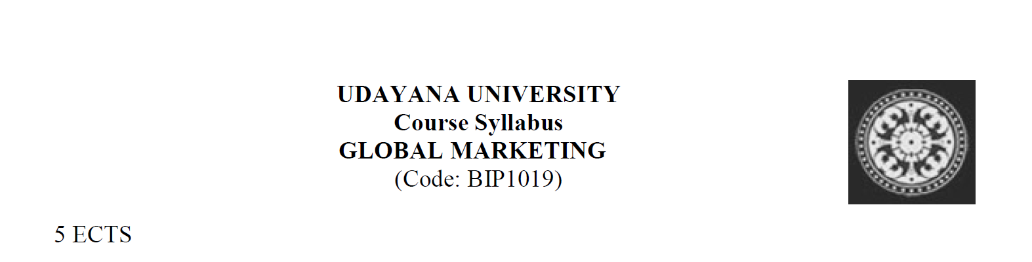
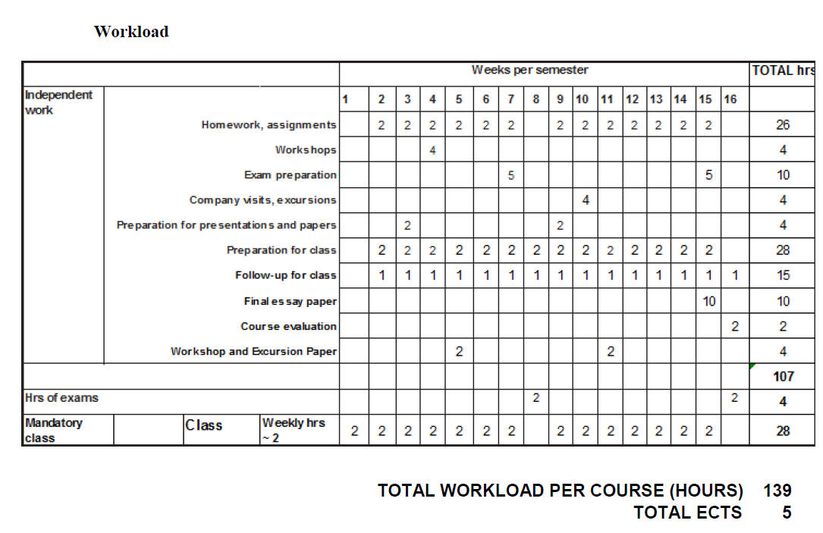
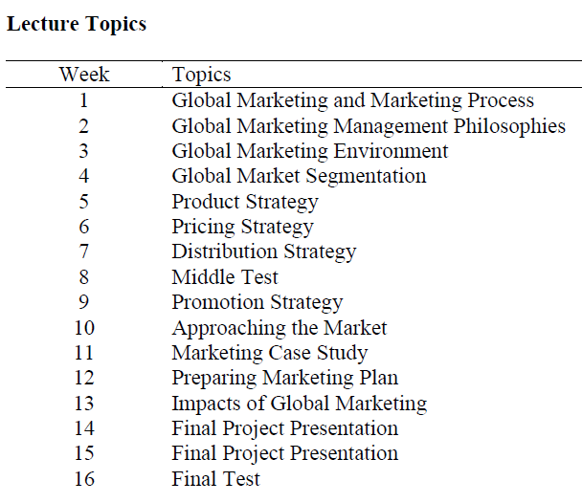
# of credits | 3 RK | 5 ECTS
# of weeks | 15 | 16
Lectures | 30 hours | 28 hours
Practical lessons | 15 hours
Self-study | 90 hours | 107 hours
Total workload | 135 hours | 139 hours

Slide 12
# of credits | 3 RK | 5 ECTS
# of weeks | 15 | 14
Lectures | 30 hours | 56 hours
Practical lessons | 15 hours | 24 hours
Self-study | 90 hours | 50 hours
Total workload | 135 hours | 130 hours

Slide 13
SYSTEM OF GRADING
The ECTS grading scale is based on student work towards other students’ work.
ECTS system divides students on the groups ‘pass’ and ‘fail’, and then grade the work of each group separately. Students who got ‘pass’ are divided to 5 subgroups: the best get A, then next 25% - B, next 30% - C, next 25% - D and last 10% - E.
 | ECTS | Recommendations
System of grading | Measures relative success of learning based on statistical distribution of students who successfully passed a course; Motivates to learn by creating highly competitive environment; Requires formed and of effective feedback mechanisms. | Implementing students’ rating; A system of self-study should be complemented by a feedback mechanism to correct learning activities in order to achieve expected learning outcomes.

Slide 14
THE SYSTEM OF EVALUATION ECTS AND RK
Description of ECTS grade | ECTS | RK | RK, % | Description of RK grade
Outstanding level of knowledge which exceeds the level of required knowledge of material/ creative approach to discipline learning | А | А А- | 95-100 90-95 | Excellent
Excellent level of knowledge within the limits of required material, could be with some mistakes | В | В+ В В- | 85-89 80-84 75-79 | Good
Usual good level of knowledge with marked mistakes | С | С+ С С- | 70-74 65-69 60-64 | Satisfactory
The level of knowledge is below average with significant mistakes | D | D+ D | 55-59 50-54 | Satisfactory
Minimum acceptable level of knowledge | E
Unsatisfactory level of knowledge, but with the opportunity to retake an exam | FX | F | 0-49 | Unsatisfactory
Unsatisfactory level of knowledge, course retake is required | X

Slide 15
ECTS METHODOLOGY AND RECOMMENDATIONS
 | ECTS | Recommendations
Organisation of students self-study | Labor input of self-study is determined by the expected learning outcomes of the specific discipline, types of learning activities and individual students’ features; Achievements of learning outcomes directly depend on quality of student’s self-study | To develop methodology of student’s self-study from the learning outcomes aspect Effective application of informational resources to support student’s self-study
Diploma supplement | Provide transparency of educational content | Revise the conversion factors and the correspondence between the evaluation systems

Slide 16
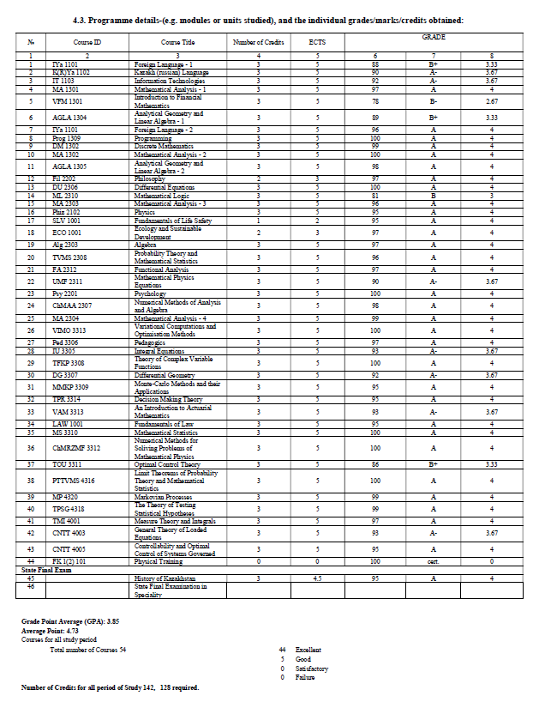
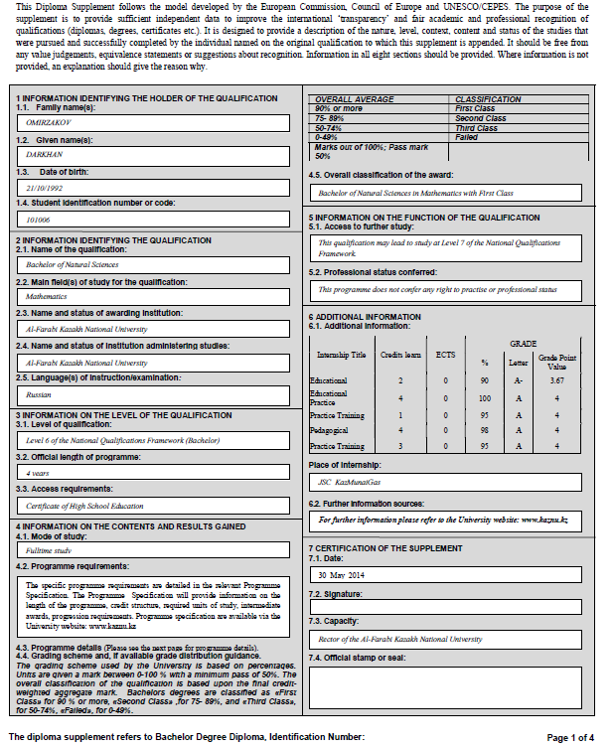
DIPLOMA SUPPLEMENT (КАЗАХСТАН)

Slide 17
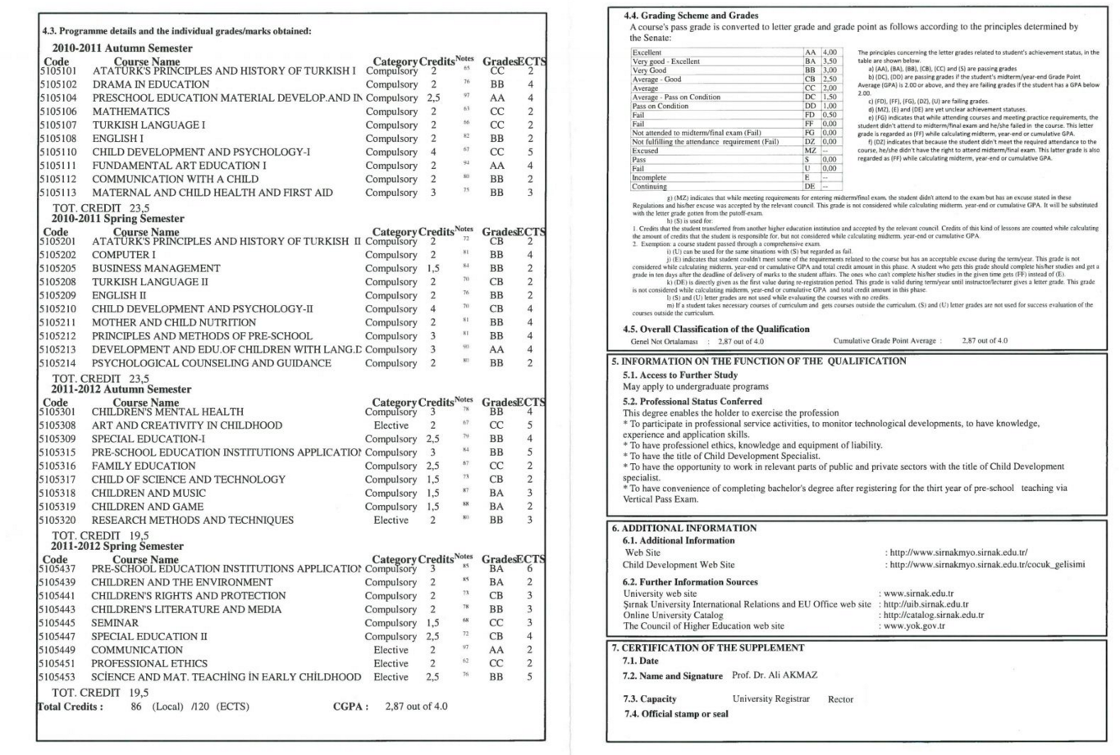
DIPLOMA SUPPLEMENT (ТУРЦИЯ)

Slide 18
THANK YOU FOR YOUR ATTENTION!

